Slide 1


Mysore University School Of Engineering
University Of Mysore
Manasagangotri campus, Mysuru-570006
(Approved by AICTE, New Delhi)
Major Project Phase-II
On
‘AI-Powered PDF Query System’
Under the Guidance:
Poornashree Narayani S Kulkarni
Assistant Professor,
Department of Computer Science and Design,
MUSE.
Group Members:
Niharika B (21SECD26)
Srihari S (21SECD45)
Utsav M(21SECD52)
Manju Samartha K S (21SECD92)

Slide 2

Contents
Introduction
Problem Statement
Problem Objectives
Literature Survey
Methodology
System Components
Technical Workflow
Potential Application

Slide 3

Introduction
AI-Powered PDF Query System is an intelligent document analysis system that transforms static PDF documents into dynamic, queryable knowledge sources. By leveraging advanced AI models and semantic search, it enables natural language querying, providing fast, accurate, and context-aware insights. This innovative solution simplifies document comprehension and enhances productivity across various industries.

Slide 4
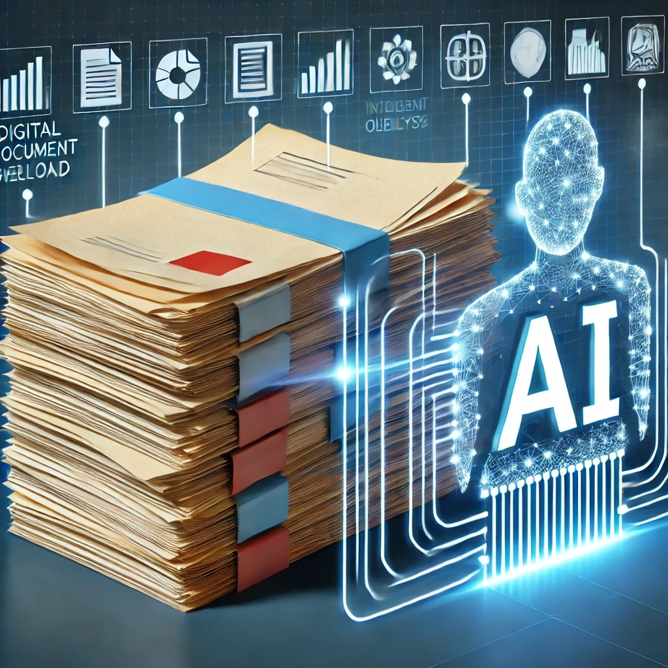
Problem Statement:
Digital document growth creates information overload, making manual review inefficient. Intelligent solutions are needed to enable fast, effective document querying and boost productivity.

Slide 5

Project Objectives
1
To develop an AI-powered tool capable of analyzing PDF documents and streamlining the extraction of useful information from text and tables.
2
To enable users to ask natural language questions about the content of a document and retrieve specific, relevant answers efficiently.
3
To generate context-aware and accurate responses using a large language model, helping users better understand complex documents without manual reading.

Slide 6
Literature Survey
Research Area
Focus
Author
Structured Information Extraction
(2024)
Extracting knowledge from scientific texts using LLMs
John Dagdelen, Alexander Dunn
Conversational AI for Data Extraction (2024)
Utilizing LLMs with engineered prompts for automated data extraction
Maciej P. Polak, Dane Morgan
Procedural Text Mining
(2024)
Extracting procedural information from unstructured text with LLMs
Anisa Rula, Jennifer D’Souza
AI-powered Literature Review Suite (2024)
Integrating features for searching, downloading, and extracting content from PDF files
David A. Tovar

Slide 7

System Requirements
Hardware
  •Minimum 8 GB RAM (16 GB recommended for smoother performance)
  •Quad-core processor or higher
  •GPU optional but beneficial for faster LLM inference
Software
  •Python 3.9 or higher
  •Node.js and npm for frontend
  •Modern browser for accessing frontend interface

Slide 8



Methodology
PDF Processing
Extracting text, tables
Chunk document into manageable segments
Preserve contextual information
1
Embedding Generation
2
Use SentenceTransformer for semantic embedding
Convert text chunks to vector representations
Enable semantic search and retrieval
AI Model Integration
3
Utilize Phi-3.5-mini
Generate contextually relevant answers
Support advanced natural language understanding

Slide 9
Architectural Foundation: Tech Stack Unveiled
The AI PDF Assistant's robust functionality is built upon a carefully selected tech stack, ensuring efficiency and scalability across all layers of interaction and processing.
Frontend
React + Tailwind CSS + animations
Backend
FastAPI
Text Extraction
pdfplumber (for digital PDFs)
Table Extraction
Microsoft Table Transformer (via Hugging Face)
Embedding Model
Sentence Transformers (all-MiniLM-L6-v2)
Vector Store
ChromaDB (in-memory or persistent)
LLM
Hugging Face hosted model (e.g. Phi3.5-mini pulled through ollama)

Slide 10
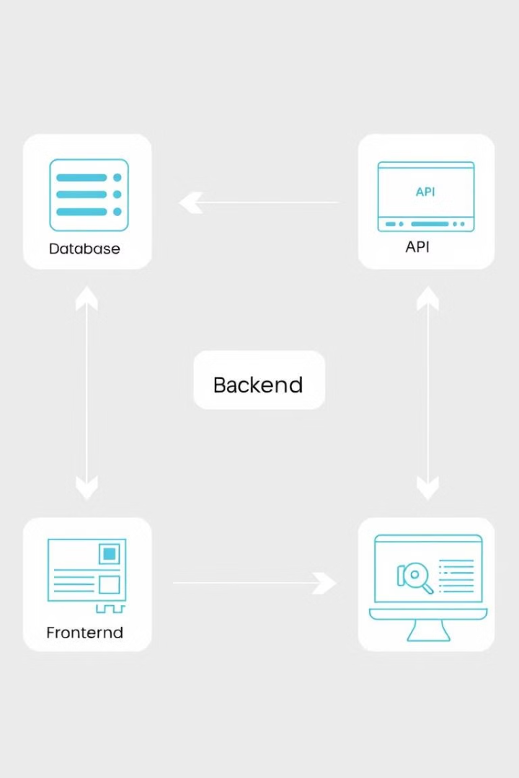




System Components
Backend
Frontend
Python Programming Language
Flask-based API for data processing and model interaction
React web interface for user
interaction and visualization
Embedding Database
LLM Model
ChromaDB for efficient storage and retrieval of vector embeddings
Phi-3.5-mini for advanced natural language understanding and
response generation

Slide 11
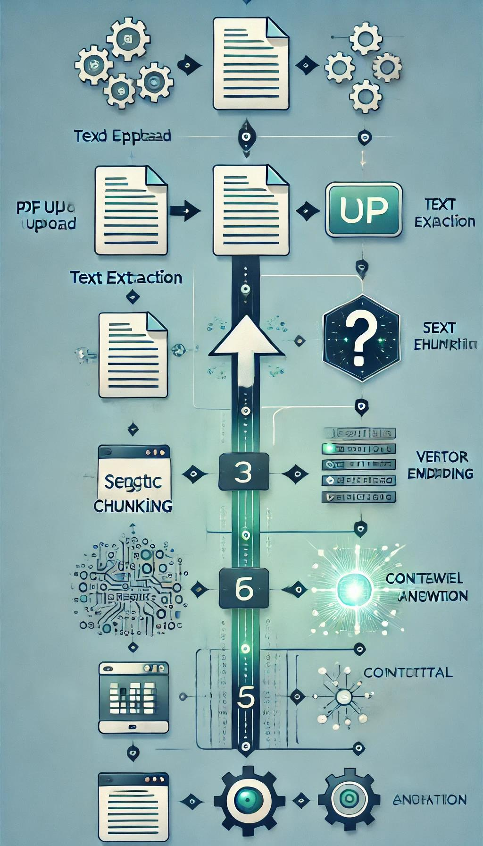






Technical Workflow
Step 1
PDF Upload
Step 2
Text Extraction
Step 3
Semantic Chunking
Step 4
Vector Embedding
Step 5
Query Processing
Step 6
Contextual Answer Generation

Slide 12
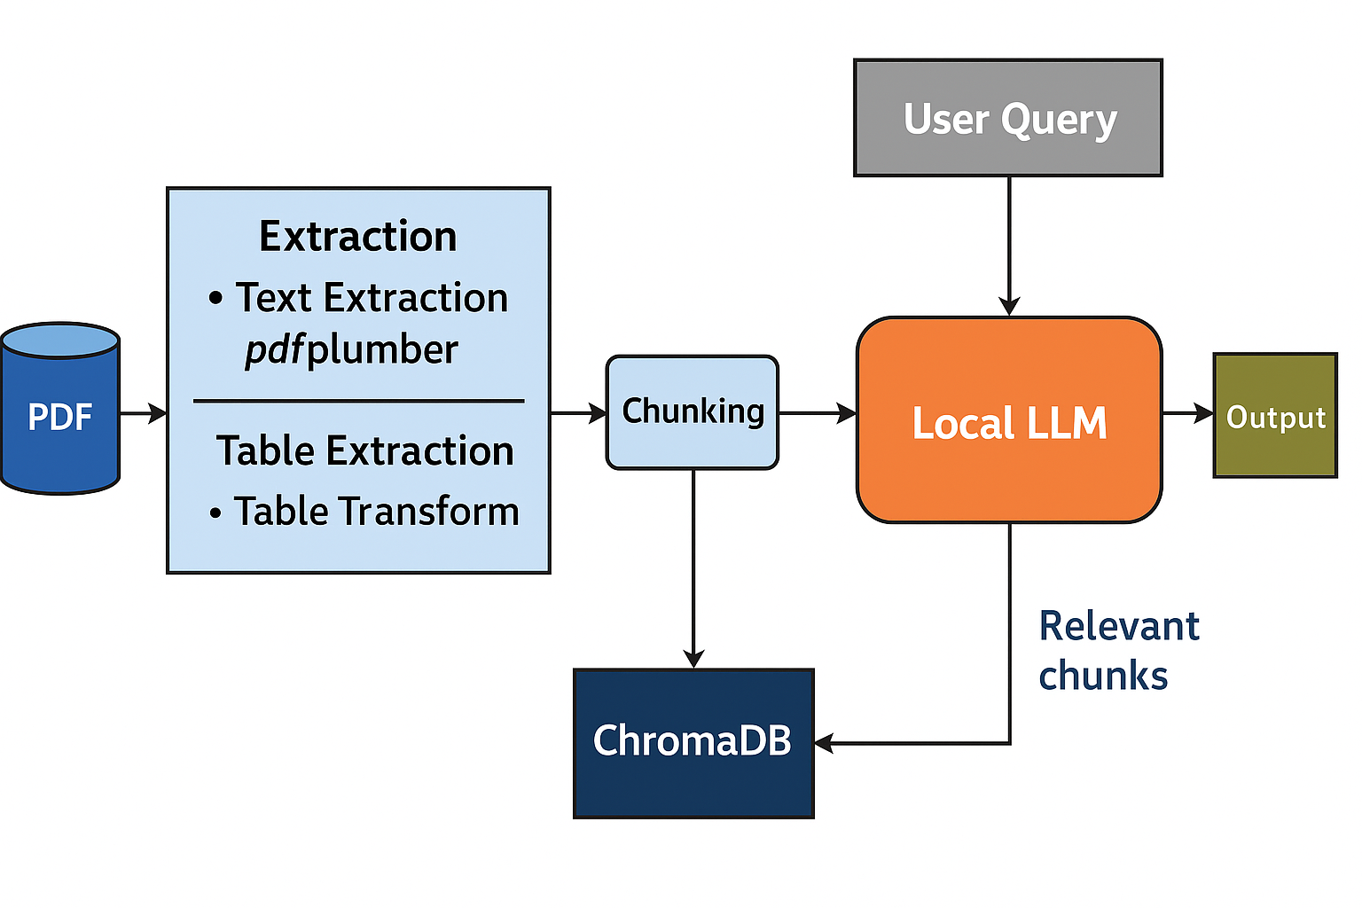
System Architecture
• A PDF is first uploaded by the user.
•Text and tables are extracted using tools like pdfplumber and Table Transformer.
•The extracted content is divided into smaller, meaningful chunks.
•These chunks are converted into embeddings and stored in ChromaDB, a vector database.
•When a user asks a question, it is also converted into an embedding and compared with the stored chunks to find the most relevant ones.
•The selected chunks and the question are sent to Phi-3.5 Mini, a local language model.
•The model generates an answer based on the retrieved content, which is then returned to the user.

Slide 13

Potential Applications
Academic Research
Legal Document Analysis
Extracting key information from scientific literature
Facilitating legal research and contract review
Technical Documentation Review
Corporate Knowledge Management
Streamlining understanding and knowledge sharing in technical fields
Organizing and retrieving critical information within large organizations

Slide 14
Future Enhancements
  •Multilingual support via translation layer
  •Voice-based querying and response
  •Better table rendering in UI
  •PDF summarization feature
  •Model upgrade (e.g., Phi-3.5 Medium or Mixtral)
  •Deployment as a web app or Chrome extension
  •Fine-tuned models for specific domains (law, science, etc.)

Slide 15
CONCLUSION
The system transforms static PDFs into smart, queryable documents.
Combines AI models, semantic search, and a user-friendly interface.
Boosts productivity and simplifies information access across domains.
Lays a strong foundation for future enhancements.

Slide 16
THANK YOU

